Slide 1
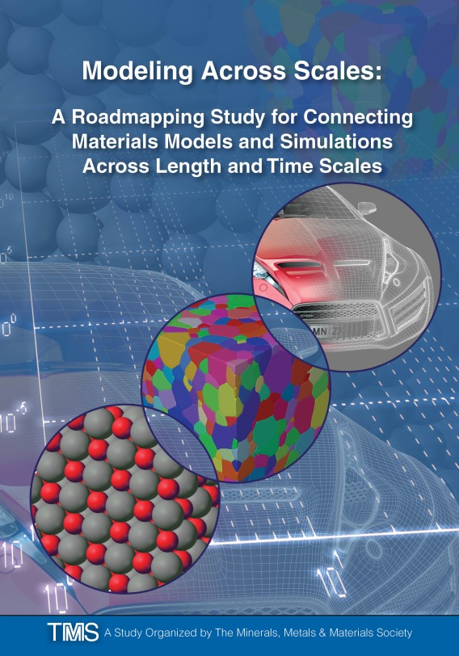
Modeling Across Scales:
A Roadmapping Study for Connecting Materials Models and Simulations Across Length and Time Scales
Available for free download at www.tms.org/multiscalestudy
Details 16 recommendations that address bridging materials models across length and time scales.
Specifies tactics, personnel, and timeframes for each recommendation.
Identifies more than 30 key gaps and limitations in materials multiscale modeling.
Reviews the current state of the art, with a detailed reference list.
Organized by The Minerals, Metals & Materials Society (TMS) and sponsored by the National Institute of Standards and Technology (NIST), Materials Measurement Laboratory.

Slide 2
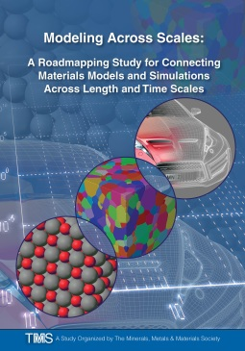
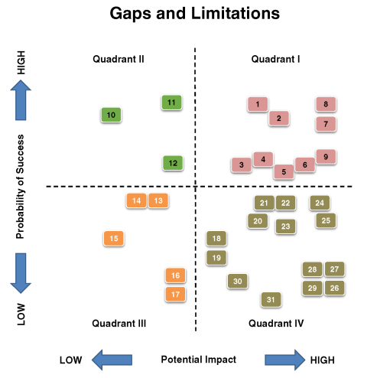
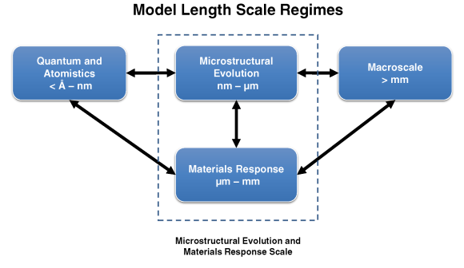
Modeling Across Scales:
A Roadmapping Study for Connecting Materials Models
and Simulations Across Length and Time Scales
Available for free download at www.tms.org/multiscalestudy
Details 16 recommendations that address bridging materials models across length and time scales. Each recommendation includes:
Required personnel or expertise
Relevant length scale regimes
Specific and actionable tactics
Projected implementation timeframes
Identifies more than 30 key gaps and limitations in materials multiscale modeling.
Ranked by difficulty and potential impact
Reviews the current state of the art.
Fundamental models and software
Existing methods for bridging scales
Detailed reference list
Organized by The Minerals, Metals & Materials Society (TMS) and sponsored by the National Institute of Standards and Technology (NIST), Materials Measurement Laboratory.

